Slide 1
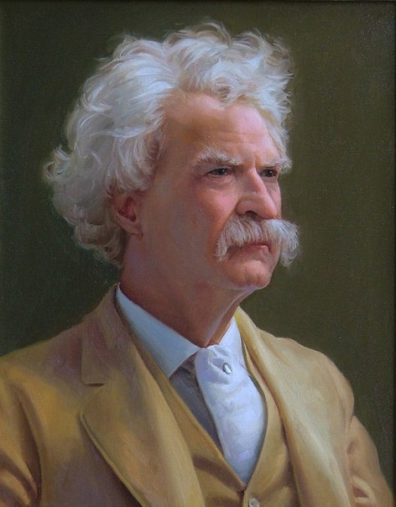
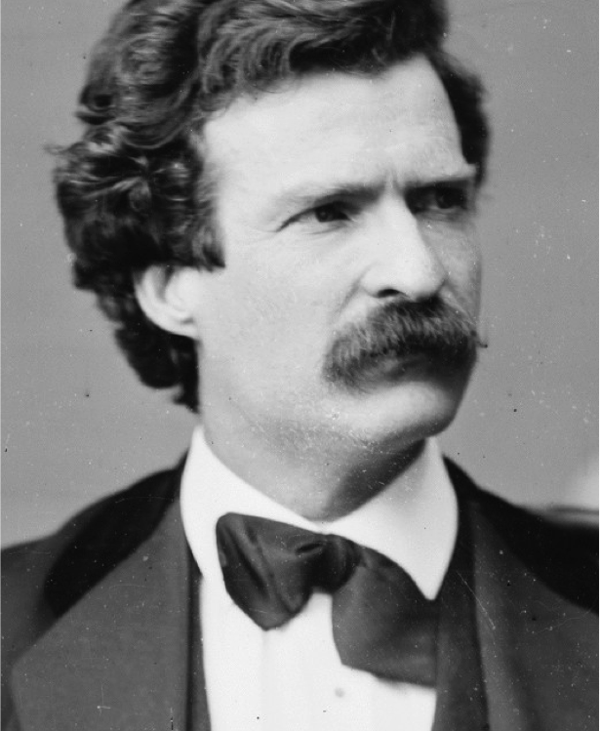

Slide 2
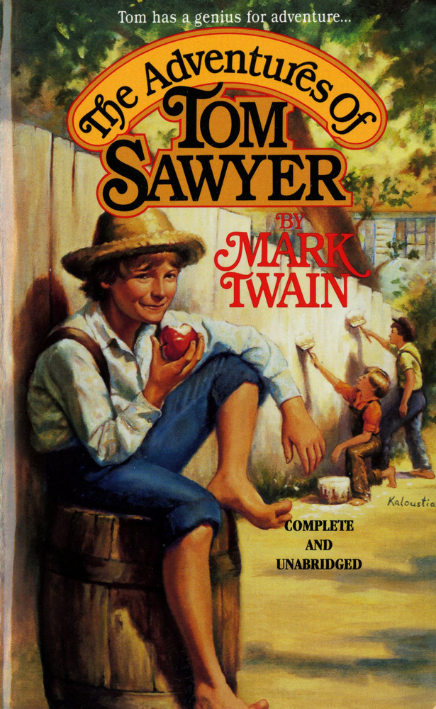

Slide 3
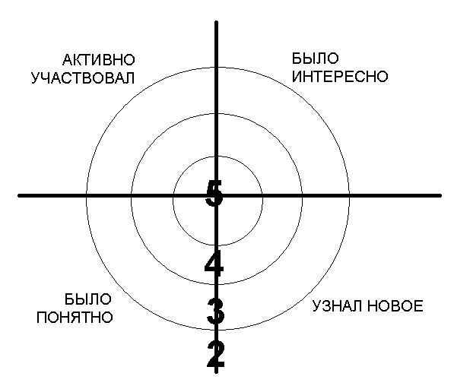

Slide 4


Slide 5

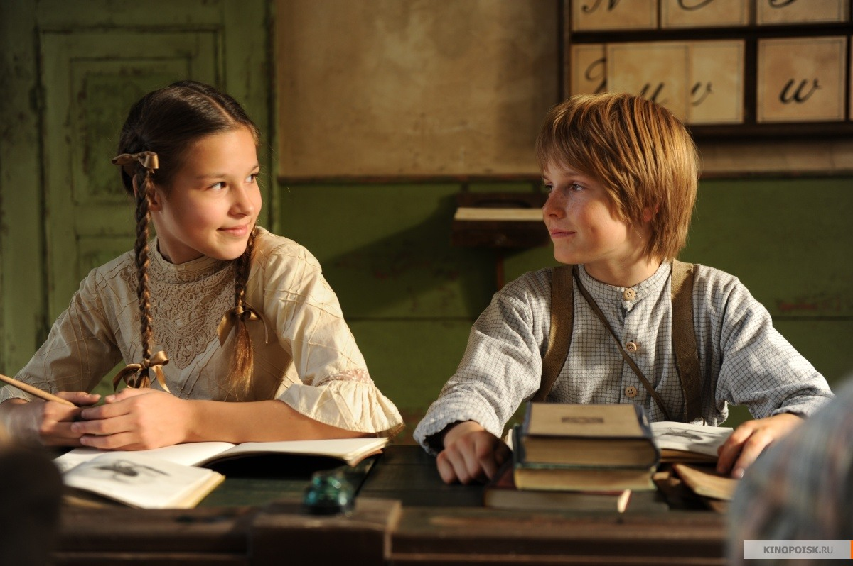
I do recommend you to read this book. Five stars is not enough for this book. This is still the most important American novel. It is a must read for anyone interested in understanding American fiction.

